Slide 1


CabMe
Ashish Khurana
ashishkhurana.iift1618@gmail.com
(+91-9953326901)

Slide 2

Preliminary Analysis
Preliminary Analysis
No. of records=1,404,726 ~1.4 Million
No. of Attributes=21
Duration considered: 1st June 2016 to 30th June 2016
Vendors: 2 Vendors namely vendor-1 and vendor-2
Location: (Latitude,Longitude)~ (41,-73.8) ~ New York City, USA

Slide 3
Data Dictionary
Column Name | Description | Data Type | Levels
Vendor ID | ID of the taxi vendor | integer | 2 levels-(1,2)
lpep_pickup_datetime | Pick up Timestamp | Datetime | Timestamp ranging from 1st June 2016 to 30 June 2016
Lpep_dropoff_datetime | Drop off Timestamp | Datetime | Timestamp ranging from 1st June 2016 to 30 June 2016
Store_and_fwd_flag | Flag to indicate something | character | 2 Levels –(Y,N)
RateCodeID | ? | integer | 7 levels – ( 1,2,3,4,5,6,99)
Pickup_longitude | Longitude coordinate location of Pick up | Float | Quantitative continuous variable
Pickup_latitude | Latitude coordinate of Pick up | Float | Quantitative continuous variable
Dropoff_longitude | Longitude coordinate of Drop off | Float | Quantitative continuous variable
Dropoff_latitude | Latitude coordinate of Drop off | Float | Quantitative continuous variable
Passenger_count | Count of the passengers in the cab | integer | 10 levels- (0 to 9)
2nd Factor :Benefit of Synergies
Purchasing, logistics and administration from neighboring countries business unit
4th Factor :Provision of risk
Short-term and current factors that could lead to postponement of market entry

Slide 4
Data Dictionary(contd.)
Column Name | Description | Data Type | Levels
Trip_distance | Distance of the trip | integer | 2 levels-(1,2)
Fare_amount | Fare of the ride(in Rupees)
Extra | ?
MTA_tax | ?
Tip_amount | Extra tip given by Passenger
Tolls_amount | Toll charges payable to authorities
Ehail_fee | ?
improvement_surcharge | ?
Total_amount | Total amount paid by passenger
Payment_type | Id of the Payment Mode | integer | 5 Levels- (1,2,3,4,5)
Trip_type | Type of the trip | integer | 3 levels-(1,2,NA)

Slide 5
Univariate Analysis
Quantitative Variable
Column Name | Mean | Median | Range
Passenger count | 1.359 | 1 | (0,9)
Fare_amount | 12.5 | 9.5 | (-499,3347)
Extra | 0.3 | 0.5 | (-4.5,4.5)
MTA_tax | 0.4 | 0.5 | (-0.5,0.5)
Tip_amount | 1.3 | 0 | (-13.2,300.8)
Improvement Surcharge | 0.29 | 0.3 | (-0.3,0.3)
Total_amount | 15.09 | 11.76 | (-499,3349.3)

Slide 6
Univariate Analysis
Qualitative Variable
Majority of the rides (about 85%) carries only 1 Passenger while 7.5% of rides carries 2 Passengers

Slide 7
Question-1
Question1
Ques1: Count the number of taxi rides on each day
Solution:
File Attached
File Name: day_count.csv
Column Name | Description
Date | Date
Count | Number of taxi ride starting on that particular day
Insights:
1)Weekends have peak taxi rides
2)Average taxi rides on Saturday is highest followed by Sunday

Slide 8
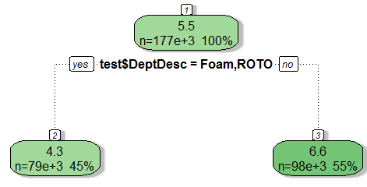
Question2
Ques2:To analyze the efficiency of each machine using variables such as Job number, Part number, Run time, Down Time, Good parts and Scrap parts
Insights:
1)Foam and ROTO Department has least Run-Time
2) The Down time of drops observed from the given data is between 04:00 to 07:00
3)Highest number of taxi drops occurs in the slot :18:00 to 19:00
4) Lowest number of taxi drops occurs in the slot :05:00 to 06:00

Slide 9
Question-3
Question3
Ques3:Count the number of taxi drops taking place in the 24 hours of the day
Solution:
File Attached
File Name: drop_hour_count.csv
Column Name | Description
Hourly Slot | Slot of the drop
Count | Number of drops taking place in that particular hourly slot
Insights:
1)The peak time of drops observed from the given data is between 16:00 to 20:00
2) The Down time of drops observed from the given data is between 04:00 to 07:00
3)Highest number of taxi drops occurs in the slot :18:00 to 19:00
4) Lowest number of taxi drops occurs in the slot :05:00 to 06:00

Slide 10
Question-4
Question4
Ques4: Count the number of trips taking place in various durations
Solution:
File Attached
File Name: duration_hour_count.csv
Column Name | Description
Hourly Slot | Slot of the drop
Count | Number of trips starting in that particular hourly slot
Insights:
1)The peak time of picks observed from the given data is between 17:00 to 20:00
2) The Down time of picks observed from the given data is between 04:00 to 07:00
3)Highest number of taxi ride occurs in the slot :18:00 to 19:00
4) Lowest number of taxi ride occurs in the slot :05:00 to 06:00

Slide 11
Question-5
Question5
Ques5:Count the number of trips by each unique vendor available
Solution:
File Attached
File Name: vendor_count.csv
Column Name | Description
Vendor ID | Unique ID of the vendor
Count | Number of taxi rides by a particular vendor
Insights:
1)There are 2 Vendors namely Vendor1 and Vendor2
2) Majority of the trips (about 80%) are conducted by Vendor--2

Slide 12
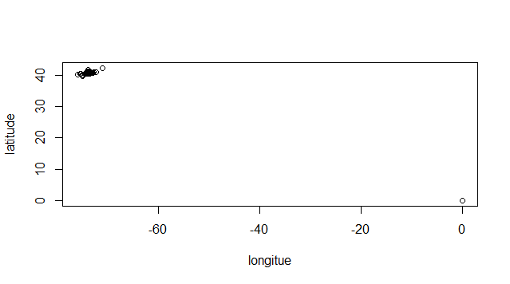
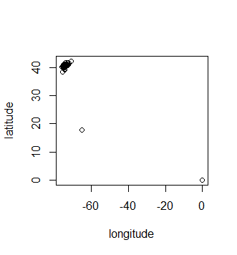
More on Latitude and Longitude
Preliminary Analysis
To Identify the latitude and longitude range
Pick up points Latitude and Longitude
Drop off points
Latitude and Longitude
Column Name | Mean Latitude | Mean Longitude
Pick up Point | 40.69° | -73.83°
Drop Off Point | 40.70° | -73.85°
Insights:
Most of the pickup and drop off latitude & longitude is centred around :41° and -73.8°.
This latitude and longitude correspond to the “New York City”,USA

Slide 13
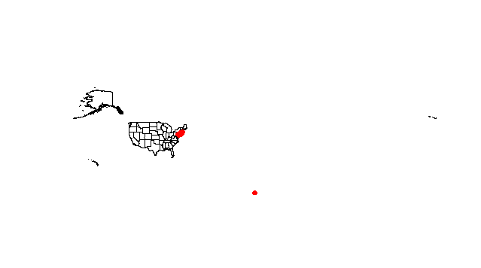
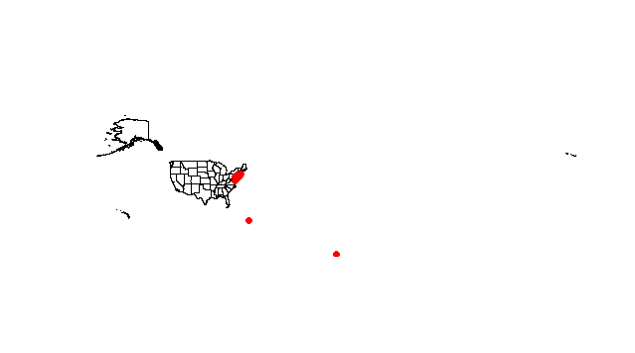
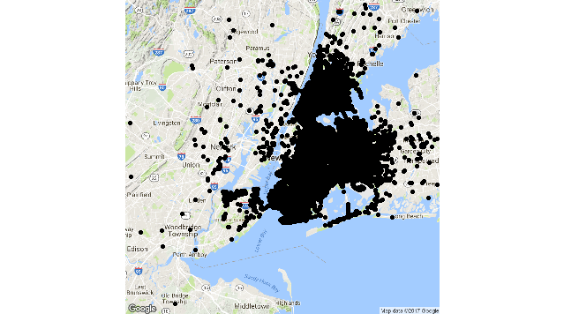
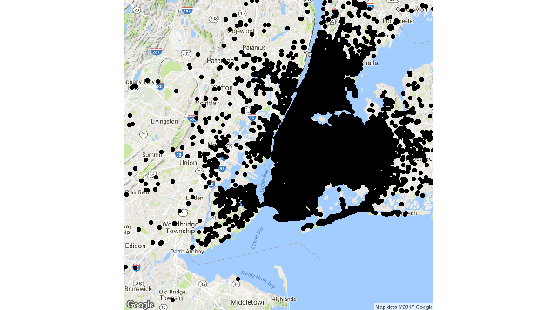
More on Latitude and Longitude
Analysis continued
To plot the latitude and longitude on the USA map and New-York city map
Pick up points
Drop off points
USA Map
Map of
New York
(Normal View)

Slide 14
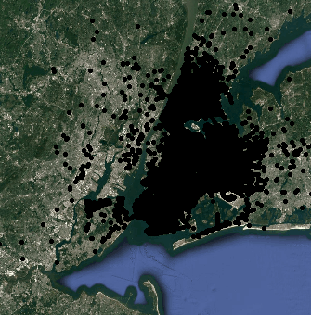
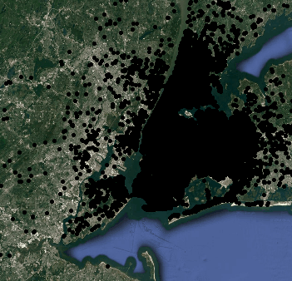
More on Latitude and Longitude
Analysis
To plot the latitude and longitude on the map
Pick up points
Drop off points
Map of
New York
Satellite View)

Slide 15


